Slide 1
Improving Governments’ Public Decisions During Covid-19 Using Geospatial Analysis On Social Media Data
By Ali Harakeh
Notes:
To start with, this research title was geospatial intelligence on covid-19 using social media data and web data. But as geospatial intelligence is a mean to an end, we decided to base this research on a ore concrete goal which was improving government decisions.

Slide 2
Content
Introduction
Problem Definition
Background & Related Work
Contribution
Results & Discussions
Conclusion
Notes:
We will talk first introduce our research, then talk about the problems we faced and then introduce some concepts the this research used and related work. After that, we will talk about what we did, discuss them, and conclude this presentation

Slide 3
Introduction

Slide 4
Introduction
COVID-19, first being identified in December 2019 in Wuhan, China, was declared a Public Health Emergency of International Concern in January 2020 and a pandemic in March 2020.
Spreads most often via physical contact of contaminated surfaces or through the air when people are at close range of an infected person as he breathes, coughs, sneezes, talks, or sings.
As of October 9, 2020, there have been 36.5 million cases confirmed globally as well as more than 1.06 million deaths attributed to this pandemic.
Both the pandemic and response measures have contributed to social and economic disruption.
Around 100 million people are expected to fall into extreme poverty and global famines for 130 million people.
It has also led to the postponement or cancellation of events, widespread supply shortages, partial or fully closing of Educational Institutes, with various alternatives used, and many incidents of xenophobia and racism against Chinese people.
Notes:
As governments try to ease these pandemic effects on society and apply their planned measures, they need to have a way to track how these changes affected society and social stability as this pandemic requires the combined efforts of both government and society to prevent further spread of this virus. People usually care about decisions that affect their current situation more than logical or scientific measures that they can't see the result of directly. For that purpose, governments should have more insights into people's movements, thoughts, and opinions that they can reflect upon when making decisions.
This research uses Twitter Social Media Platform to get the data from and analyze it.

Slide 5
Problem Definition

Slide 6
Problem Definition Social Media Content Languages
Language | Phrase
English | How are you?
Arabic | كيف حالك؟
Lebanese (English) | Kifak? or Kefak? or Keefak?
Lebanese (Arabic) | كيفك؟
Notes:
Different forms and formats
Different use of characters

Slide 7
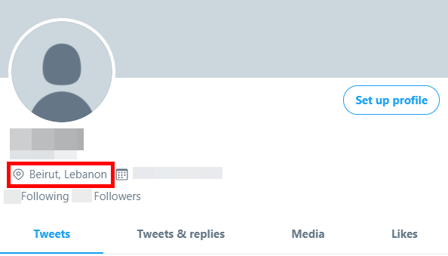
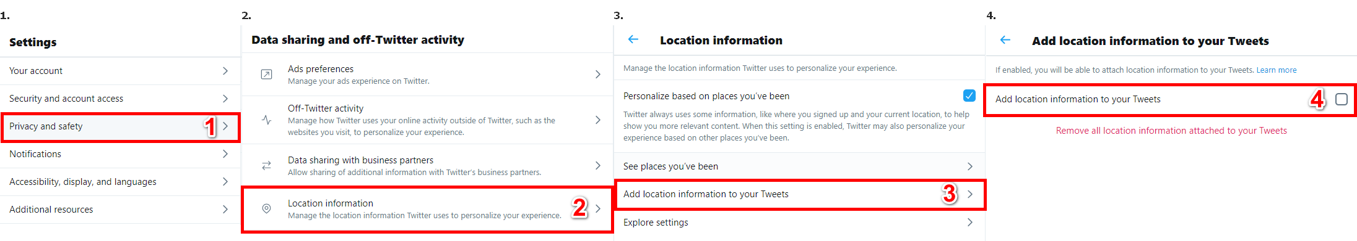
Problem Definition (cont.) User’s Location
Notes:
Geo tweets
Provided location usually empty and not filled seriously
Location access is OFF by default and not many know about it or they just ignore it
Results: Not much tweets

Slide 8
Background & Related Work
Background
GIS
Geospatial Analysis
ArcGIS
Text Mining
Fuzzy Searching
Machine Learning
Notes:
- GIS: Geographic information system that collects, analyze, visualize geographic data.
- Geospatial Intelligence : the intelligence of human activity on earth.
- ArcGIS: Esri Implementation of GIS.
- Text Mining: techniques to understand the context of text and categorize it.
- Fuzzy Searching: is the process of locating terms that are likely to be relevant to a searched argument even when this argument doesn't exactly match these terms.
- Machine Learning: focuses on the development of computer programs that can access and use data to learn on their own.

Slide 9
Background & Related Work (cont.)
Related Work
This Research
Different Social Media Platforms
Geo-Tagged social media data
Maps
Smart Dashboards
Twitter Social Media Platform
Location extraction based on users tweets and profiles
ArcGIS Online Platform for maps and dashboard
Notes:
- Seina Wubo

Slide 10
Contribution

Slide 11
Contribution (cont.)
Proposed Solutions
Location Extraction
Unifying Languages
Public Reactions Analysis
Sentiment Analysis
Emotions Analysis
Public Interactions Analysis
Topics Extraction
Public Activity
Notes:
workflow

Slide 12
Contribution (cont.) Location Extraction

Slide 13
Location Extraction Location Data
3000+ Locations Data
English names
Arabic Names
Latitude
Longitude
Kadaa
Mohafaza
Notes:
- Need to know the details of locations first

Slide 14
Location Extraction (cont.) Extracting Locations
Arabic & Lebanese-Arabic
English & Lebanese English
Both languages had the same location names.
A prefix was often added before the location name.
Some Lebanese-Arabic location names often had slight characters differences.
Both languages used the same letters but differed greatly in usage.
Both languages often had mismatched characters for the same location name.
There were many ways to write the Lebanese-English location names in.
Both languages location names often had the same sound.
Notes:
- can’t use same method for both

Slide 15
Location Extraction (cont.) Extracting Locations (cont.)
Arabic & Lebanese-Arabic
English & Lebanese English
Word | Problem | Location Result | Method
ببيروت | Prefix “ب” | بيروت | Partial sub-string search
تل اخضر | Missing “ال” in “اخضر” | تل الاخضر | Levenshtein Distance Formula (Edit Distance)
Word | 4-digit Soundex Codex
Beirut | B630
Beyrut | B630
Beyrouth | B630
بيروت | 000ب (Doesn’t work for Arabic)
Word 1 | Word 2 | Edit Distance
Beirut | Beyrut | 1 edit(s) required
Beirut | Beyrouth | 3 edit(s) required
Beyrut | Beyrouth | 2 edit(s) required

Slide 16
Contribution (cont.) Unifying Languages

Slide 17
Unifying Languages Google Translate
Good Results, But:
Lebanese | Google Translate
Kn mnsab bas sa7 halla2 | Be the position, but correct Hala
Eh walla nsab bl marad | Uh, not lineage, but murad
Wasfi men edoctoor | My description is from Adster

Slide 18
Unifying Languages (cont.) Translating Lebanese Language
Lebanese-Arabic
Lebanese English
Lebanese | Translation
مرحبا | Hello
كيفك | How are you
تمام | Ok
منيح | Good
Lebanese | English
2ahwe, 2hwe, 2ahwi | Coffee
Adiim, Adiime, Adeem, Adeeme | Old
Jeser | Bridge
7arara | Temperature
LB | LB-AR | AR | EN
mr7aba | مرحابا | مرحبا | Hello
2hla | اهلا | اهلا | Welcome
2hwe | اهوي | اهوي | Ahoy
LB | EN | Word | Similarity
Hone | Here | Hon | 86%
2hwi | Coffee | 2ahwi | 89%
Kifak | How are you | Kefak | 80%

Slide 19
Contribution (cont.) Data Analysis

Slide 20
Data Analysis Workflow
Public Activity
Reactions
Sentiment Analysis
Emotion Analysis
Interactions
Topic Extraction
Public Interactions

Slide 21
Data Analysis (cont.) Sentimental Analysis
Goal: Observe whether people were accepting or complaining about their situation as taking any new measures for the pandemic without knowing how it would affect the public negatively or positively should never happen.
Details:
Already known Natural Language Processing (NLP) method.
TextBlob for text categorization (positive, negative, and neutral)

Slide 22
Data Analysis (cont.) Emotion Analysis
Goal: Take appropriate measures to keep people as hopeful and positive as much as possible since the overflow of negative emotions would cause public disruption and social upset.
Details:
Searching for words that referenced any emotion of the eight basic emotions (anger, disgust, fear, sadness, surprise, anticipation, joy, and trust)
A list of ~14,000 words that reference these eight emotions from the National Research Council Canada (NRC).

Slide 23
Data Analysis (cont.) Topic Extraction
Goal: Dig deep into the data and observe how people interacted with each other to get more insights.
Details:
TF-IDF model: Term Frequency + Weight relating to all documents
Cleaning Data (non-alphabets, spelling mistakes, and lemmatizing)
Creating Stopwords (English, Arabic, and Twitter specific)
N-grams (Bi-grams & Tri-grams)
Manual Filtering

Slide 24
Data Analysis (cont.) Public Interactions
Goal: Find any public activity that contributed to the sudden increase of Covid-19 cases where it led people to gather and have close contact with others.
Details:
Refering to Covid-19 reports to find when and where people interacted with each others the most.
Filtering the results ranges and get trending topics with their tweets.
Building the Geo-Database.

Slide 25
Results & Discussions

Slide 26
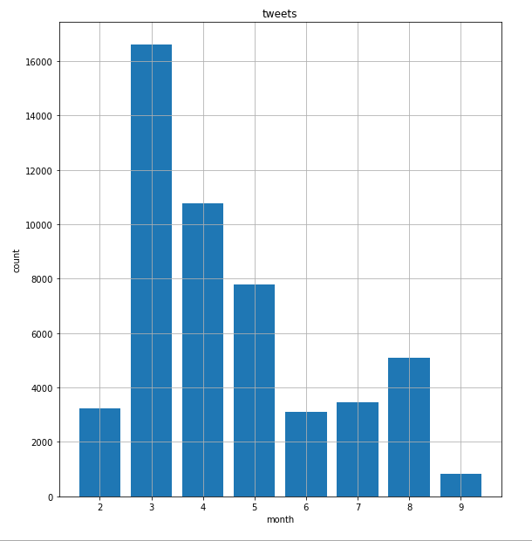
Results & Discussions (cont.) 50,000+ Tweets Sample Data

Slide 27
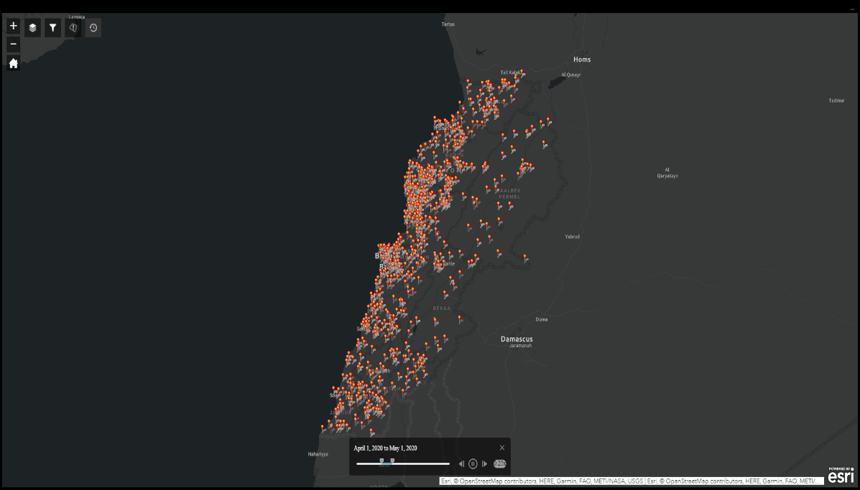
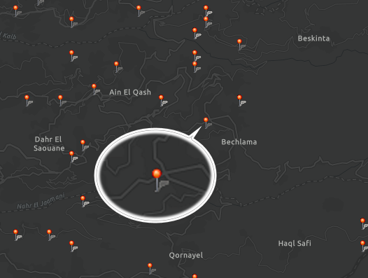
Results & Discussions (cont.) Locations
Notes:
- Location extraction and profile location

Slide 28
Results & Discussions (cont.) Unifying Languages
Lebanese | Google Translate | Tool
kn mnsab bas sa7 halla2 | Be the position, but correct Hala | was Position enough correct now
eh walla nsab bl marad | Uh, not lineage, but murad | yes indeed set up at disease
wasfi men edoctoor | My description is from Adster | prescription from doctor
Notes:
As we said before google translate did a good job, we just translated the rest
Problem: translating individual words led to bas sentence grammar/structure

Slide 29
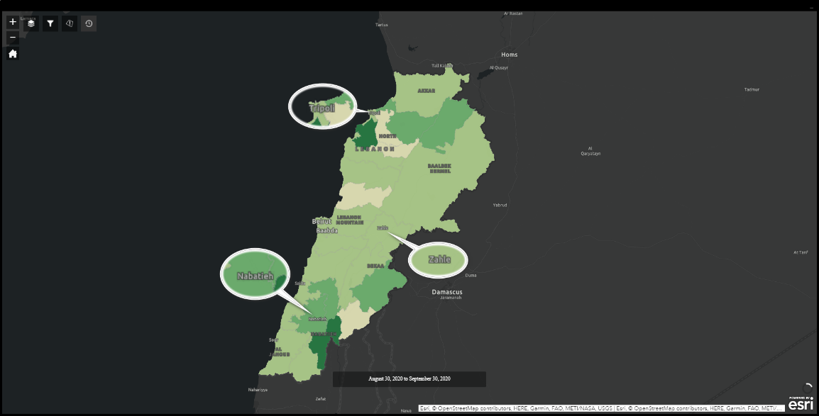
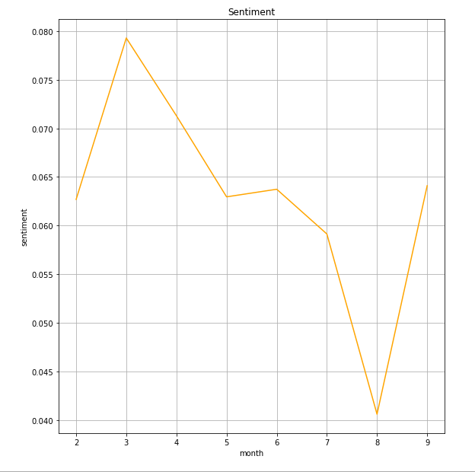
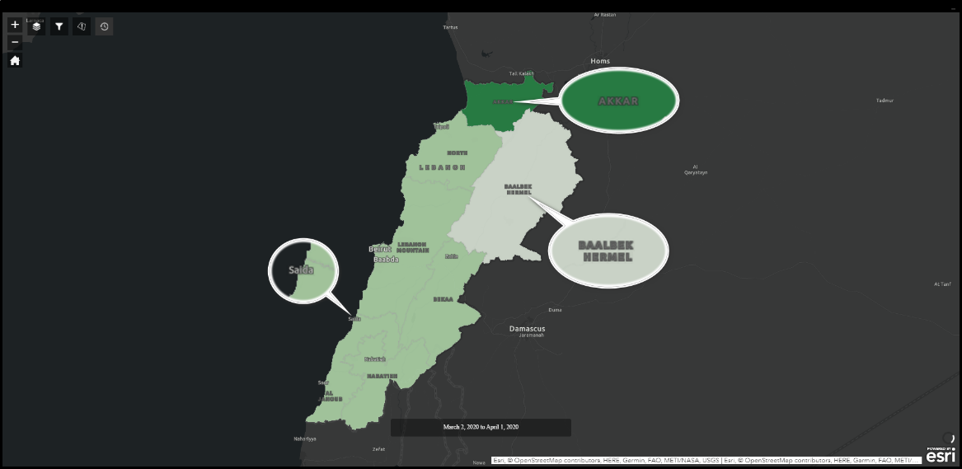
Results & Discussions (cont.) Sentiment Analysis
Notes:
- Month 2-3: positive, airport closed
Month 4-5: less positive, airport opened and cases increasead
Month 6: cases retained an avg count (not much < 50), a little calm
Month 7: people stopped caring, increase in cases
Month 8: explosion of cases and Beirut
Month 9: no one cared anymore

Slide 30
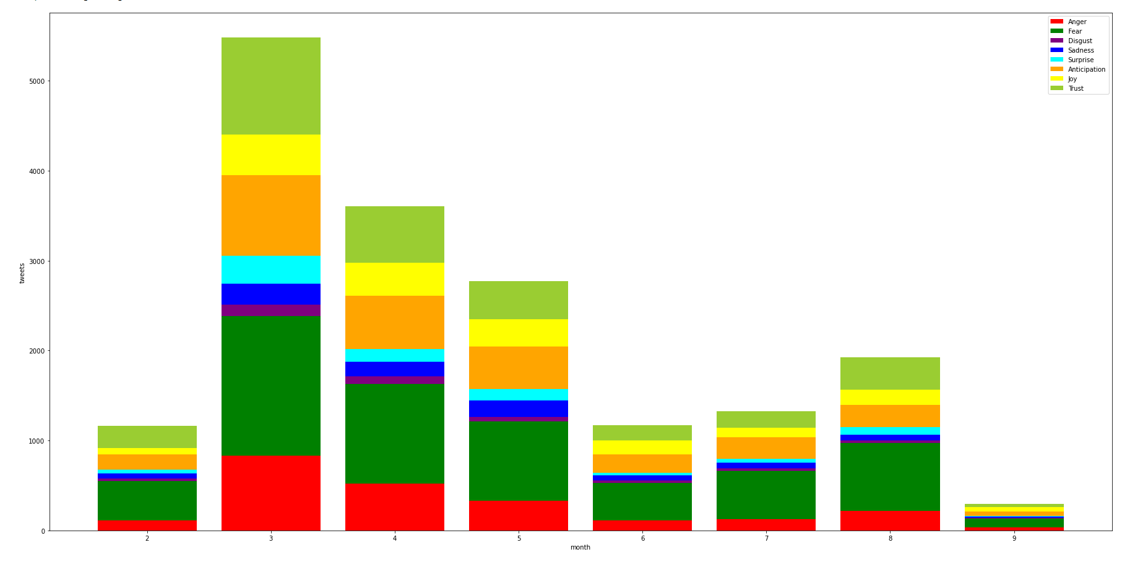
Results & Discussions (cont.) Emotions Analysis
Notes:
Month 2: no cases, just head of covid-19
Month 3: china spread and fear it will come to Lebanon
Month 4-5: airport open, cases came, but became stable
Month 6: less interest
Month 7: cases increased
Month 8: explosion of cases and Beirut, increased fear and anger
Month 9: non interest anymore

Slide 31
Results & Discussions (cont.) Topics Extraction
Month | Mohafaza | Topics
6 | الجنوب | Syrian refugees | #كورونا #لبنان | #كورونا #كورونا_لبنان | medical marijuana | #خليك_بالبيت #كورونا_لبنان | حسان دياب | #كورونا_فايروس #مدينة_صور | marijuana dispensary | #مدينة_صور #جنوب_لبنان | وزير الداخلية
Month | Kadaa | Topics
4 | بيروت | #كورونا #لبنان | #كورونا_لبنان #خليك_بالبيت | فيروس كورونا | جديدة بفيروس | إصابة جديدة | medical cannabis | #كورونا #لبنان_ينتفض

Slide 32
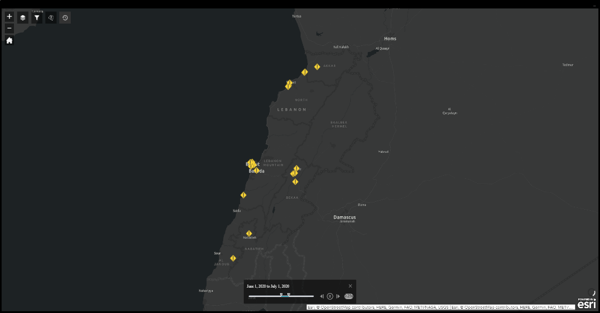
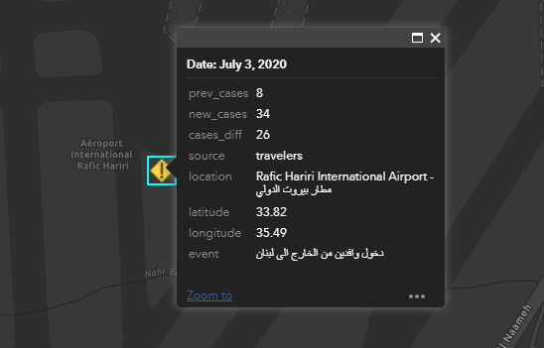
Results & Discussions (cont.) Public Activities
Date | Source | Location | Event
4/8/2020 | travelers | Rafic Hariri International Airport - مطار بيروت الدولي | دخول وافدين من الخارج الى لبنان
8/19/2020 | locals | مار مخايل - بيروت | اعمال ازالة الركام في محيط مرفا بيروت

Slide 33
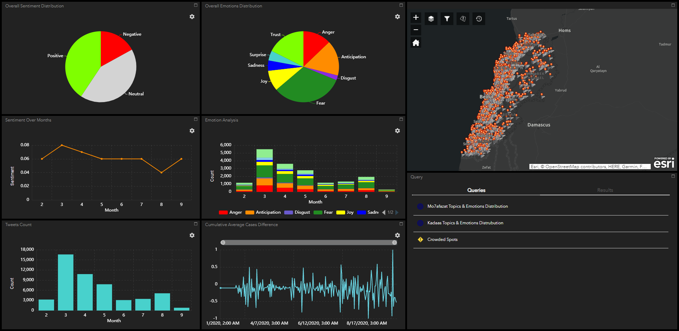
Results & Discussions (cont.) Dashboard

Slide 34
Conclusion

